Slide 1




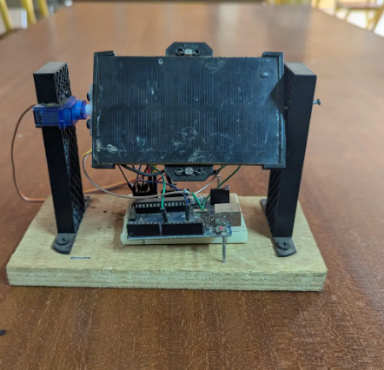
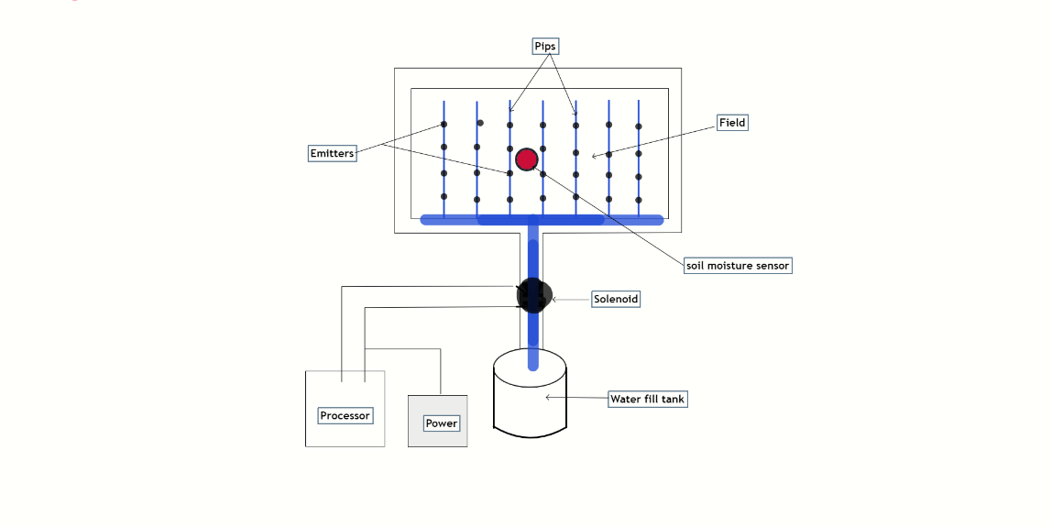
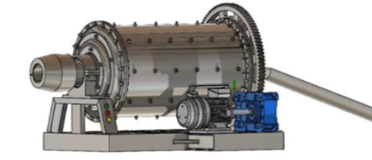
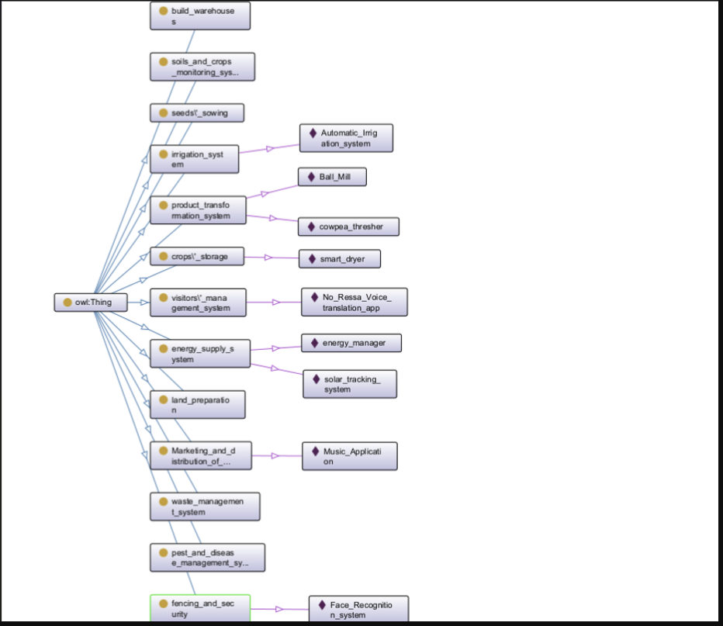
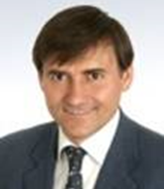
Expert Community
Expert Topics at Supply Chain
Infineon chances with a sustainable farm in Burkina Faso
Vision: Look here!
Creation of a sustainable, integrated farming system that leverages advanced technologies
Optimize output, reduce waste, and promote ecological, economic, and societal sustainability
Mission
Develop a replicable and scalable sustainable farm system.
Balance ecological, economic, and societal goals by integrating diverse projects into a unified, efficient, and cost-effective framework.
Technical Overview
Integration of Ontologies: Connect different farm processes (e.g: solar power, irrigation, and drying) through ontology-based planning for seamless collaboration.
Cost-Efficiency and Flexibility: Determine the optimal balance between flexibility and cost-efficiency for high-runner and low-runner farm operations.
Scalability and KPIs: Adapt the model to different regions and climates while establishing key performance indicators (e.g., water savings, energy efficiency, crop yield) to measure success.
Contact: Hans Ehm,
Infineon Proprietary. Copyright © Infineon Technologies AG 2024. All rights reserved.

Slide 2
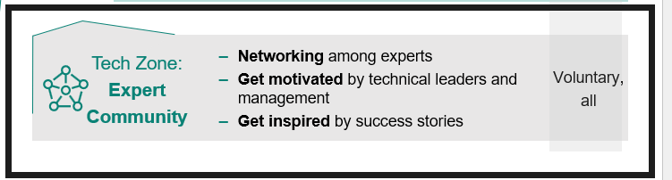
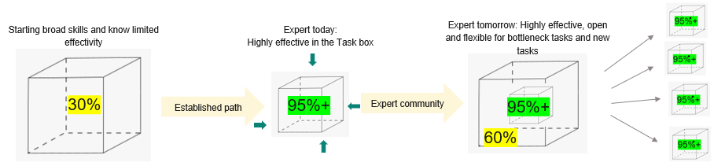
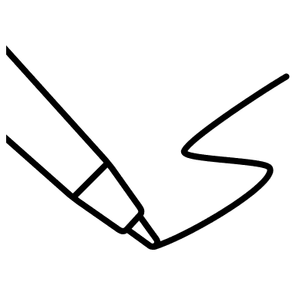
Expert Community
Expert Topics at Supply Chain
Infineon chances with a sustainable farm in Burkina Faso
SC EXPERT COMMUNITY NETWORKING with CREATIVE HOUR
GOAL: Brainwriting/Brainstorming discussing summary
Generate ideas on your own ideas, write on a sticky note
Present your sticky note idea and get it improved by the team 🡪 next team member
Discuss and align to the best idea or combination of ideas
Conclude and agree on presenter(s)
The community includes Infineon experts and offers those a platform to network among each other 🡪 an “outside the box” environment for growing
This includes guidance & clarity towards technical ladder career path
Incentivize motivation, hearing and sharing technical success stories
LINK PCNViz TO INFINEON SUPPLY CHAIN ACTIVITIES
Energy Management
Crop production and Processing
Monitoring and Automation
Sustainability and Waste management
What is the ideal balance between automation and manual intervention in crop production?
What level of customization is needed for waste systems in different regions?
What are your needs and preferences when it comes to accessing this information?
The TASK
IDEAS, SUGGESTIONS BRAINSTORM UNBIASED, PRAGMATIC APPROACHES CONTACTS, SUPPORT THINKING OUTSIDE THE BOX
Contact: Hans Ehm,
Infineon Proprietary. Copyright © Infineon Technologies AG 2024. All rights reserved.

